Slide 1
Introdution
We are
-What are we going to talk about

Slide 2
Analysis

Slide 3
Analysis
Elements of winning:
  Build Order
  Information Gathering
  Macro
  Micro

Slide 4
Analysis
Terran Tactics
  Timing Attack
  Pushing
  Harassment

Slide 5
Analysis
Unit analysis
  Marine
  Vulture
  Wraiths

Slide 6
Baysian Networks

Slide 7
Baysian Network
Choice of decision model
  Bayesian Networks
  Decision Trees

Slide 8
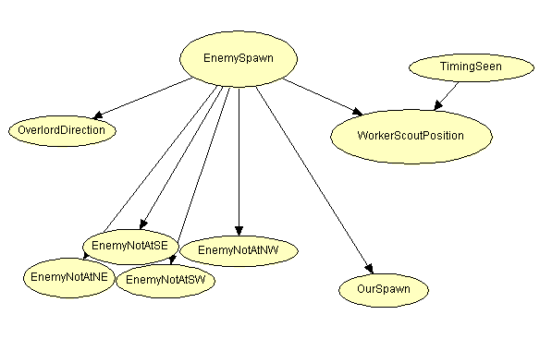
Baysian Network
Spawn Prediction

Slide 9
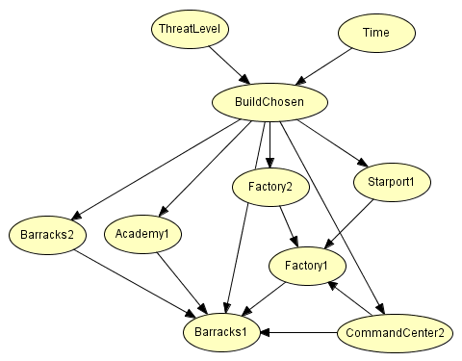
Baysian Network
Threat level prediction – tvt

Slide 10
Potential Fields

Slide 11
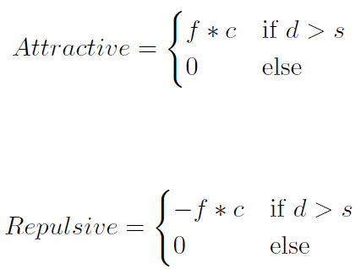
Potential Field In General
Attractive behavior
Repulsive behavior
From vector to number

Slide 12

Our Potential Field Function
Behavior is determined by + or –
due vs de
(2de - due)

Slide 13
Changed When Implementing Potential Field
All forces are positive
Forces are learned

Slide 14
Reinforcement Learning
Generalization of Q-Learning

Slide 15
Environment Variables
A State is defined as the combination of all the following characteristics:
Number of units
Health Lost
Damage Dealt
Number of Units
Time
Weapon’s Cool Down
Shooting Range
Distance to Ally
Distance from Current Tile to Ally
Distance to Center of Squad
Distance from Current Tile to Center of Squad
Distance to Enemy
Distance from Current Tile to Enemy
Distance to Cliff or Edge
Distance from Current Tile to Cliff or Edge

Slide 16
Reinforcement Learning

Slide 17
Generalization Formulas
Q-Approximation
Reward

Slide 18
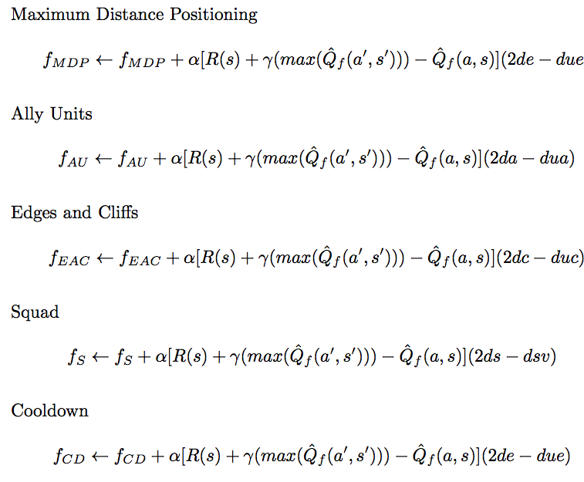
Updating Rules

Slide 19
Algorithm
Image that i’m still doing

Slide 20
TEST

Slide 21
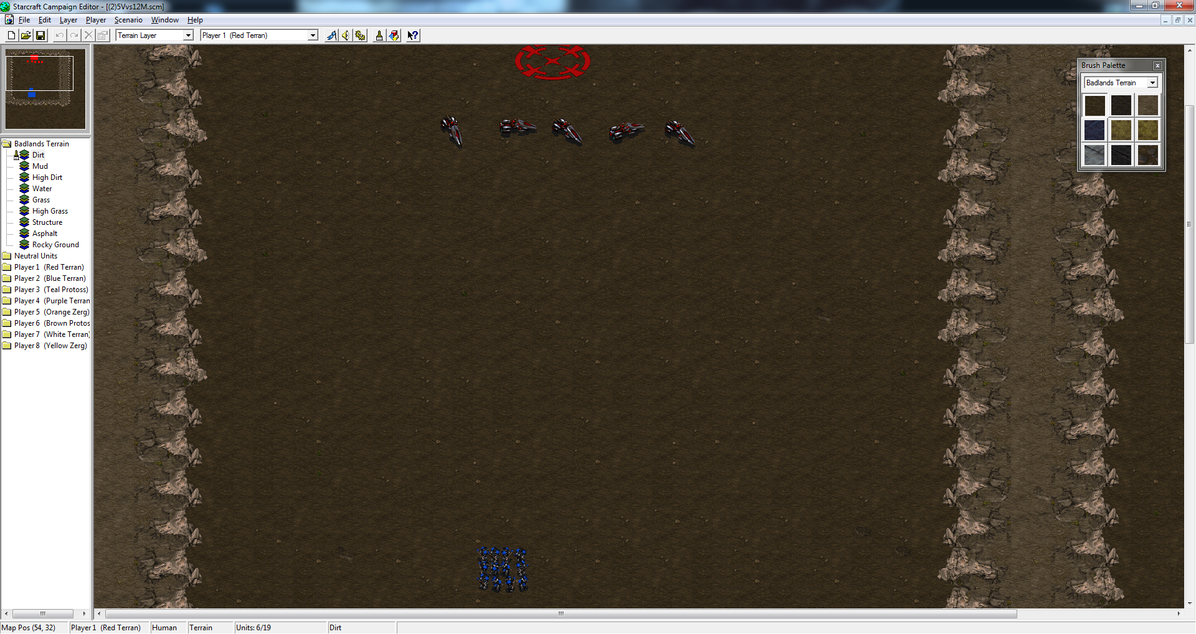
Building a test
Figure of StarEdit – a Starcraft BroodWar map editor

Slide 22
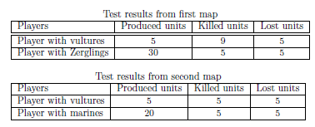
Base case
Testing without Reinforcement learning, and potential fields

Slide 23
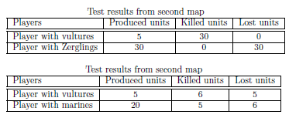
Base case
Testing with potential fields,
but not reinforcement learning

Slide 24
Will it converge?
Which Alpha and Gamma values?
How many iterations is needed?

Slide 25
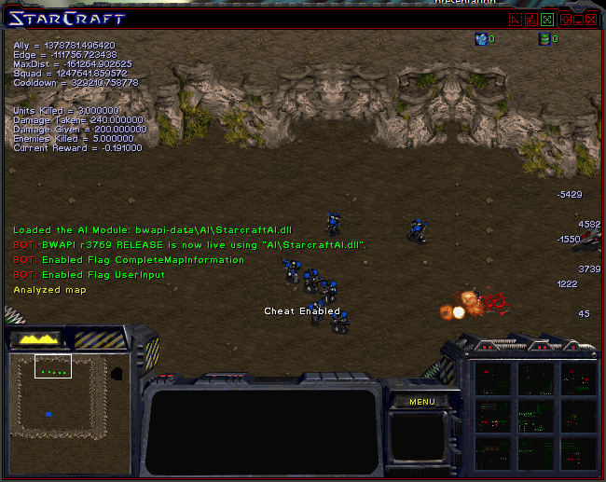
Will it converge?
Running tests with different values

Slide 26
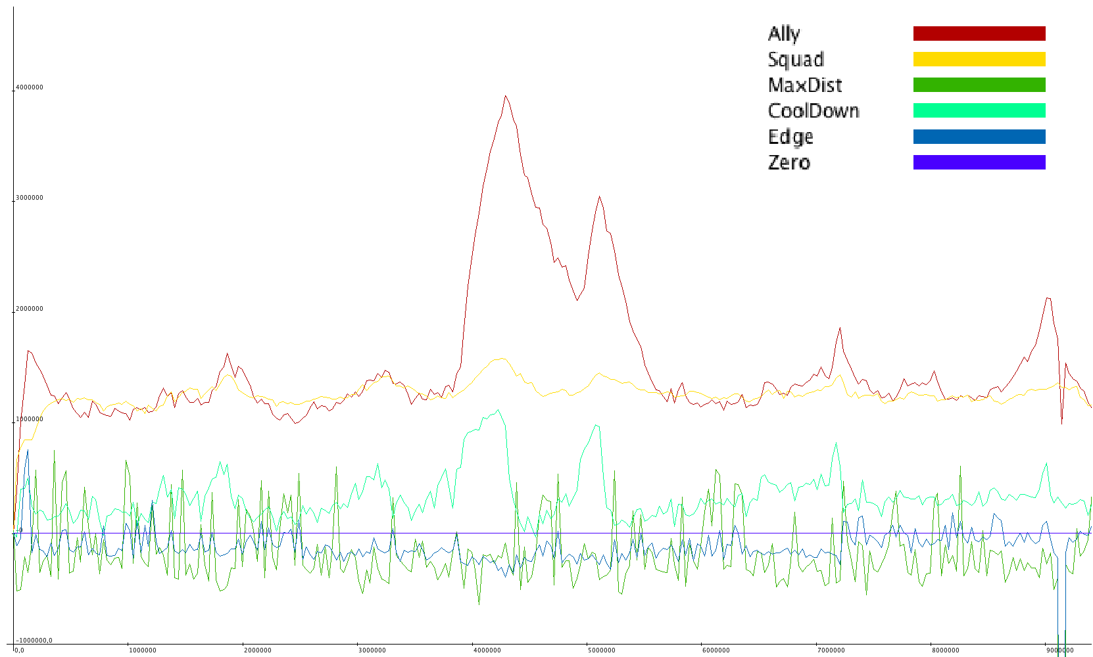
Will it converge?
Values Alpha 0,2 and Gamma 0,9 (30852)

Slide 27
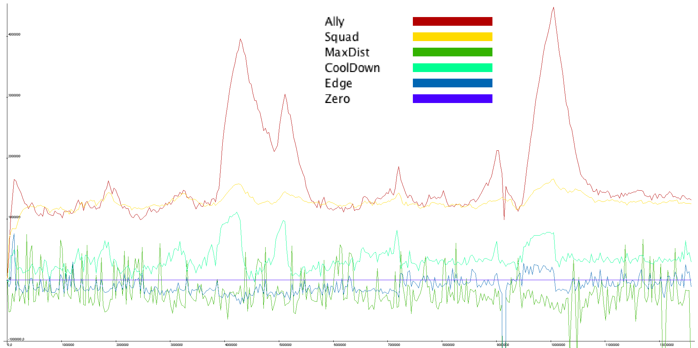
Will it converge?
Values Alpha 0,4 and Gamma 0,6 (135936)

Slide 28
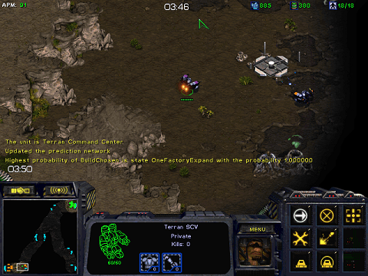
Predict spawn and build order

Slide 29
Conclusion

